Slide 1
Lightning Induced Surge
Overvoltage damage caused by Electrical Surge
CAN BE ELIMINATED

Slide 2
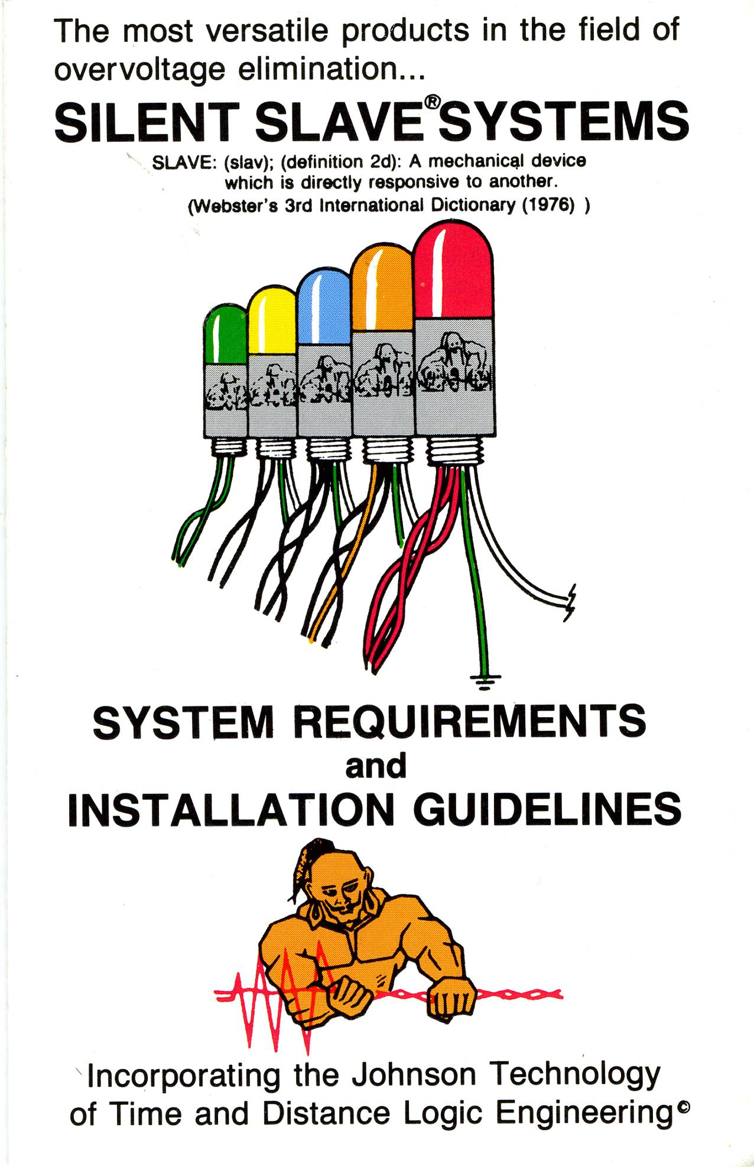
The Silent Slave overvoltage elimination system (SURGE) is inexpensive, easy to install and has 30 year proven track record with over 30,000 systems installed world wide.
This system can be installed as a complete facility protection or it can be designed to protect the more surge prone areas. Expanding the system is as easy as adding more units. Every unit added increases the level of protection.

Slide 3
Stop Lightning Induced Damage
Silent Slave will save you money and down time by keeping your equipment safe from lightning induced surge damage.
Silent Slave is installed at each electrical panel.
The distributed installation will take care of overvoltage conditions regardless of where they enter.
The faster they are suppressed the less the time to cause damage.

Slide 4
Silent Slave System Design
Silent Slave is designed as a modular device.
The level of protection can be increased by adding units. Every electrical panel within a facility can be protected by adding units. The over all facility protection is increased with each unit.

Slide 5
Protection is accumulative
The values applied to protective ampacity and joules at each main or sub panel are accumulative to facility protection.
They all work in the isolated area as well as simultaneous operation during catastrophic events.

Slide 6
Designing A System For Over All Protection
Determine Location of Units.
Determine Types of Units.
Determine Number of units
Compare to System Requirements Chart.

Slide 7
Determine Location Of Units
Locate all Main and Sub Electrical Panels, Disconnects and Contactors.
List the VOLTAGE and AMPS of each.
NOTE: If intentions are to first protect problem areas, list the panels that feed these areas. The protection of total facility can build in stages. The more units installed the greater the overall level of protection.

Slide 8
Determine Type Of Units
Determine Electrical Parameters
Model Chart
Meter AC or DC voltage between circuit conductors.
i.e. line/line, line/neutral, line/ground, neutral/ground
NOTE: An electrical network operating at 380ac would require the 4803 model. Use a 4803 on the high or wild phase of a 24oVac delta.

Slide 9
System Requirements

Slide 10
Installing The System
The installation must be performed by a licensed electrician.
Time to install will vary by location of each unit. In an electrical panel, main or sub it takes approximately 30 minutes per unit. This allows for opening the panel and getting ready to install. NOTE: Always meter the power before installing to double check you have the correct units.

Slide 11
Installing
For complete instruction of installing the Silent Slave go to technical support and down load the manual.
Always install units with cap pointing up or down. Never install unit where it can be used as a step or handle. Always point away from traffic.

